Slide 1
Body Fat Project of STAT628 Group 9
Hengyu Yang, Leyan Sun, Tianle Qiu, Yi Ma

Slide 2
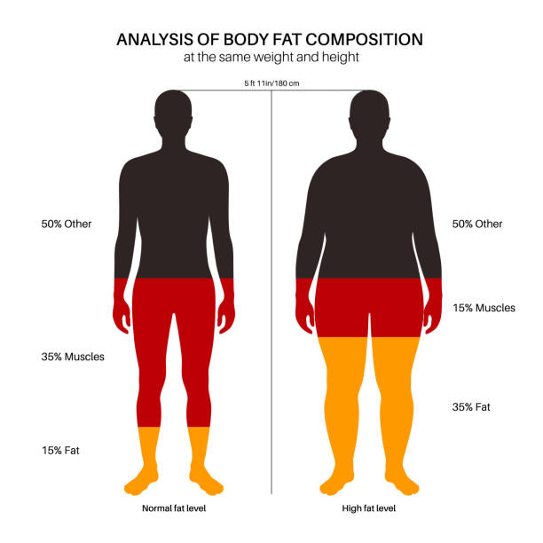
Introduction and Background
Goal: Develop a simple, accurate model to estimate body fat using common clinical measurements.
Outcome: Create an easy "rule of thumb" for quick estimation by health practitioners.
Dataset:
252 male individuals
17 variables related to body circumference
Notes:
In modern society, health has become a growing concern, with body fat being a key indicator of well-being. However, traditional body fat measurements are often inconvenient and costly. This project aims to develop a simple, accurate, and robust model for estimating body fat percentage using readily available clinical measurements. The goal is to create an easy-to-use "rule of thumb" that allows health practitioners to quickly estimate body fat with commonly accessible data.
Body fat estimation is key in managing health, particularly for preventing chronic diseases and obesity. It helps assess the risk of being overweight or obese, providing a scientific basis for creating personalized exercise and diet plans.

Slide 3
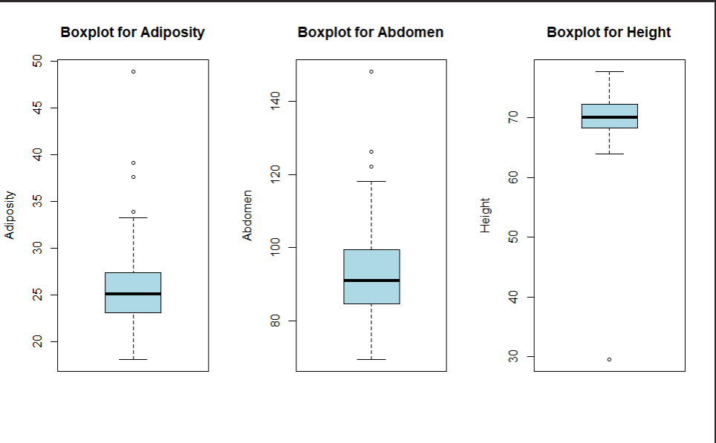
Data Cleaning
We performed exploratory data analysis on the BodyFat dataset using summary(BodyFat) in R, identified 3 suspect variables from 17, and used box plots for a more intuitive analysis of these variables.
Remove BMI outliers by excluding observations with BMI > 40.
Then, we update the height for IDNO 42 by BMI=weight/height^2 due to an extremely low value.
Finally, we apply a linear regression model trained on data with body fat ≥ 7% for those body fat < 7%.

Slide 4
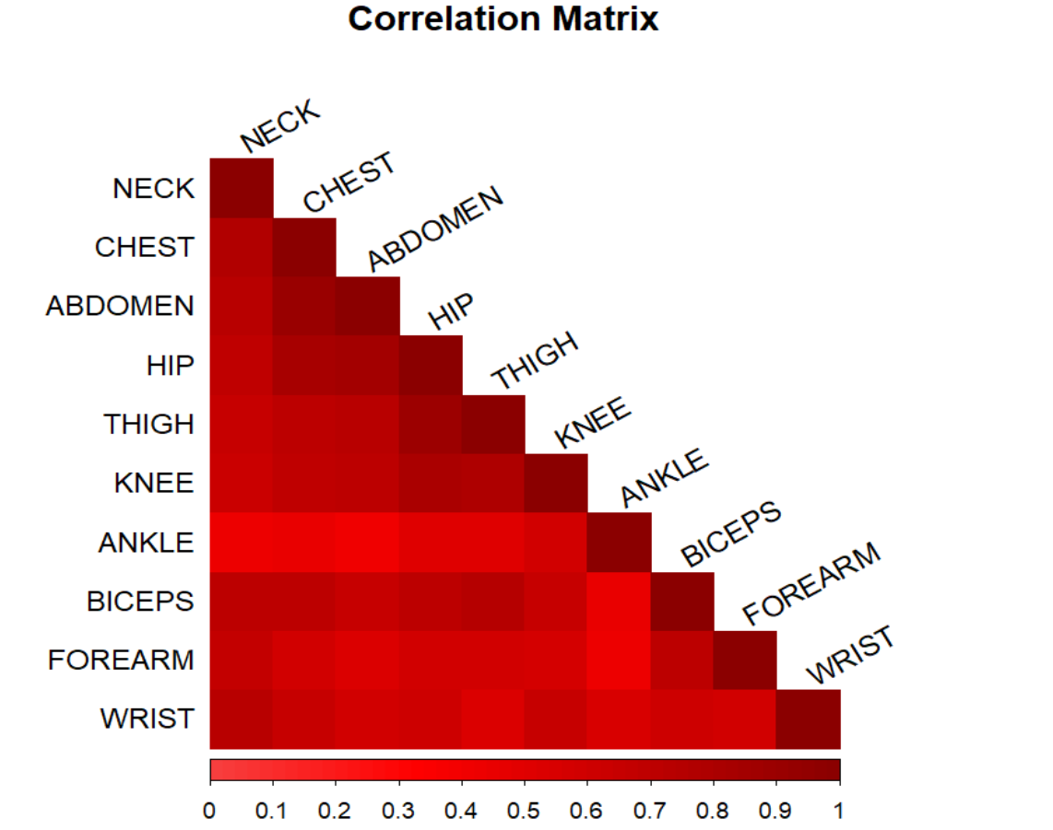
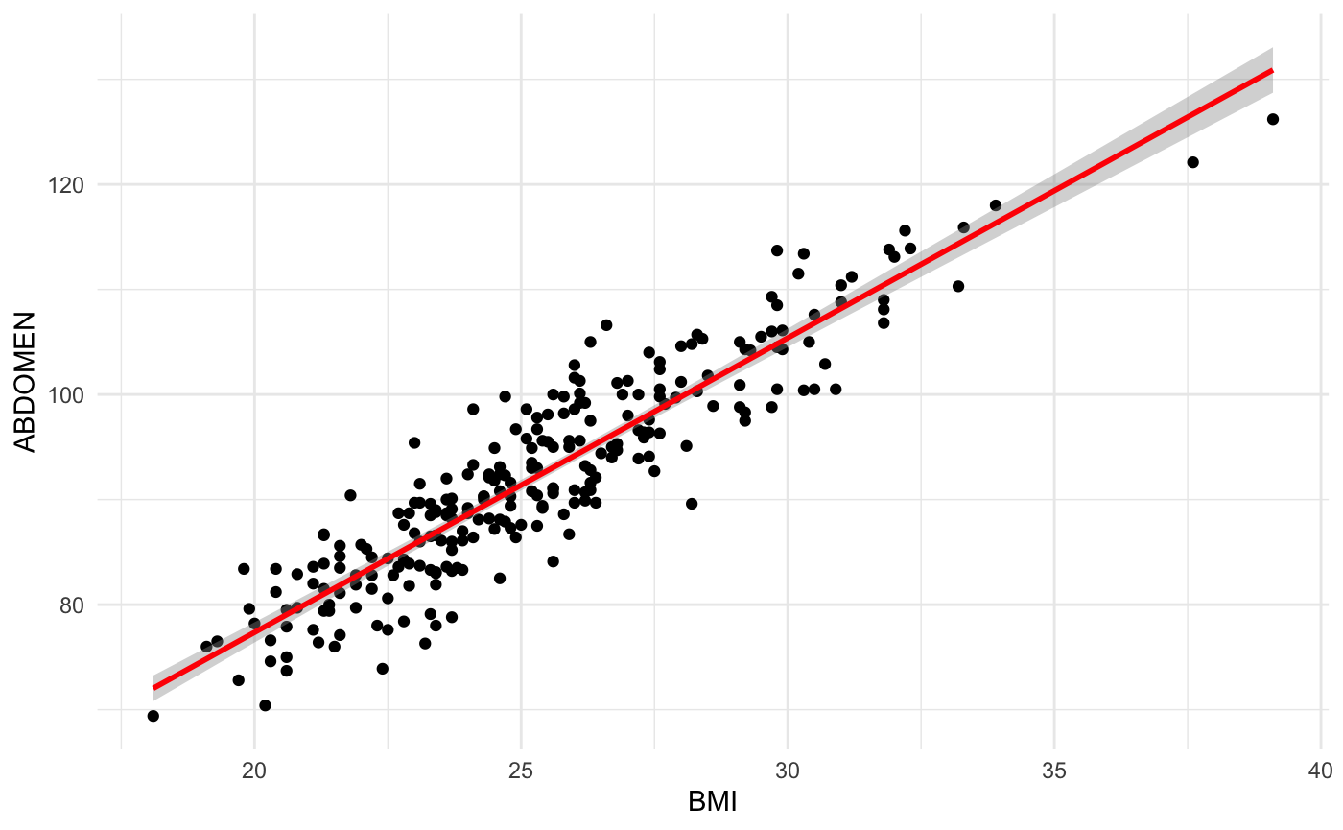
Correlation
ANKLE and FOREARM are removed because they showed relatively low correlation as indicated by their lighter color shading, focusing on variables that contribute more significantly to the prediction.
We found a strong correlation (0.916) between BMI and ABDOMEN. Since the regression coefficient for ABDOMEN was highly significant, and the two variables are closely related, ADIPOSITY was removed .

Slide 5
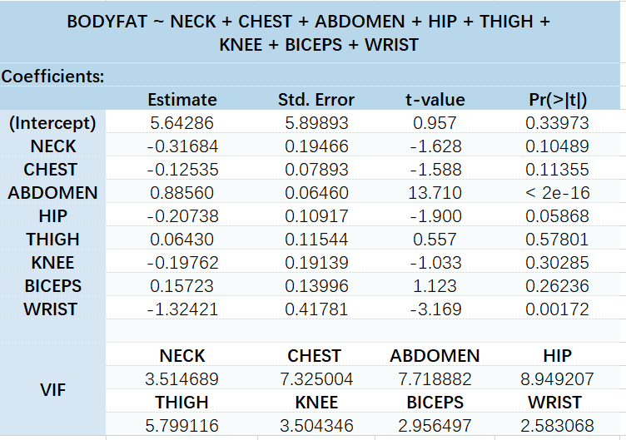
VIF for Multicollinearity
It is more reasonable to remove THIGH first, as it has both a high p-value (indicating low significance) and a moderately high VIF (5.799).
Next step is to apply stepwise regression to further refine the model. Stepwise regression is a variable selection technique that iteratively adds or removes predictors based on statistical criteria, such as AIC or BIC, to identify the optimal combination of variables.

Slide 6
Stepwise Regression
After some iterations, the model stops at:
BODYFAT ~ CHEST + ABDOMEN + HIP + WRIST
 | Estimate | Std Error | P Value
(Intercept) | 1.376 | 5.523 | 0.803
HIP | -0.184 | 0.074 | 0.136 *
CHEST | -0.136 | 0.074 | 0.067
WRIST | -1.656 | 0.346 | <0.001 ***
ABDOMEN | 0.868 | 0.063 | <0.001 ***

Slide 7
Defining the Trade-Offs
3 Possible Models:
Model 1: ABDOMEN + WRIST
Model 2: ABDOMEN + WRIST + AGE
Model 3: ABDOMEN + WRIST + HIP + CHEST
6 Metrics Used :
Metrics used: R², Adj_R², AIC, BIC, MSE, RSE.
R² and Adj_R² show how well the model explains the data.
AIC and BIC balance model fit and complexity.
MSE and RSE measure prediction error.
Notes:
Modeling body fat percentage need balancing accuracy, simplicity, and robustness.

Slide 8
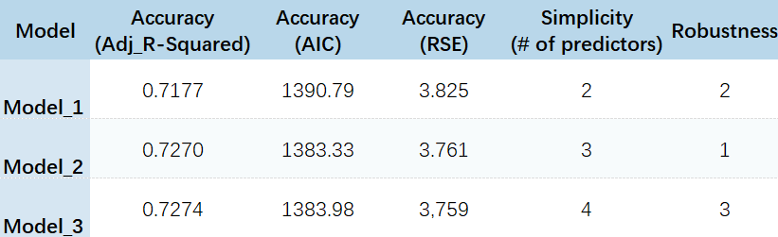
Results (Tables)

Slide 9
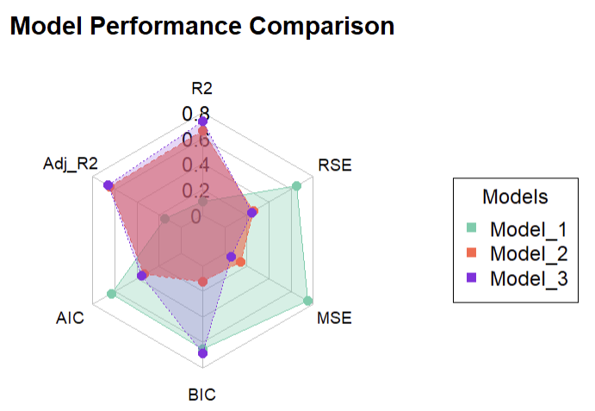
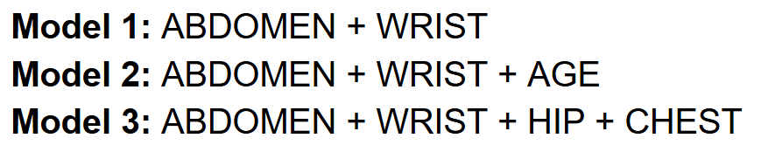
Results (Graphical)
Notes:
Model Comparison:
Final Model (Model 2) performed best, balancing simplicity and accuracy.
Model 1 (only ABDOMEN and WRIST) had low R² and high error rates, showing AGE's importance.
Model 3 (more predictors) slightly improved R² but increased complexity and BIC.

Slide 10
Describing the Final Model
BODYFAT = -6.94 + 0.676*ABDOMEN - 2.135*WRIST + 0.06*AGE
Model Selection:
Chosen for its balance of statistical significance, simplicity, and predictive power.
Key variables: Abdomen and Wrist (easy to measure), plus Age for improved accuracy.
Practical Application:
Abdomen: A 1-unit increase = +0.676% body fat.
Wrist: A 1-unit increase = -2.135% body fat.
Age: Each year = +0.060% body fat.
Notes:
The selection of this model is based on considerations of statistical significance, simplicity, and predictive capability. By use abdomen and wrist—two easily measurable variables closely related to body fat—along with age to enhance model performance, we have achieved a good balance between accuracy and practicability. We can simply apply our model in practice; for every 1-unit increase in abdominal circumference, the percentage of body fat increases by approximately 0.676%. For every 1 unit increase in wrist circumference, the percentage of body fat decreases by approximately 2.135%. For every 1 year increase in age, the percent body fat increases by about 0.060%.

Slide 11
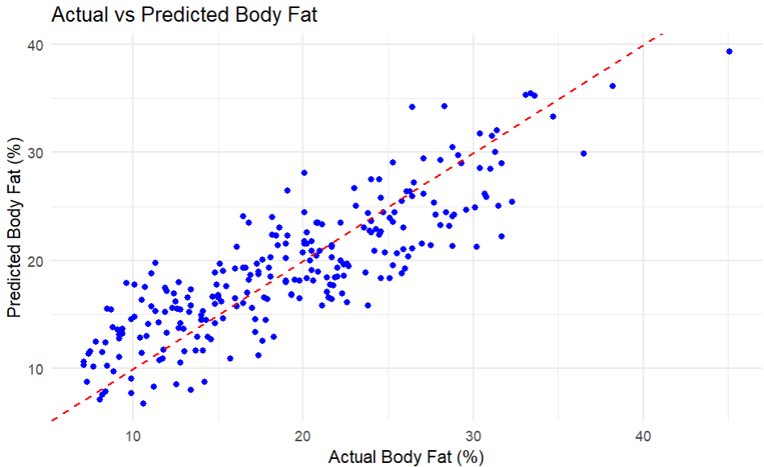
Statistical Description of Final Model
Key Metrics:
R² = 0.730
Adjusted R² = 0.727
AIC = 1383.32
RSE = 3.76
Significant Predictors:
ABDOMEN & WRIST (p < 0.001)
AGE (p < 0.01)
Notes:
We used multiple linear regression to model the relationship between percent body fat and predictor variables. We ultimately found ABDOMEN, WRIST and AGE to be the most significant. R² = 0.730: This indicates that approximately 73% of the variation in body fat percentage is explained by the final model. Adjusted R² = 0.727: After adjusting for the number of predictors, the model still retains strong explanatory power. AIC = 1383.32, the smallest compared to other models, suggests that the model show a better balance between goodness of fit and complexity. RSE = 3.76: The typical difference between the observed and predicted values of body fat percentage is about 3.76%. P-values for ABDOMEN and WRIST were both highly significant (p < 0.001), indicating that these variables are strong predictors. AGE had a smaller, but still meaningful contribution (p < 0.01).
Key Metrics:
R² = 0.730: Model explains 73% of body fat variation.
Adjusted R² = 0.727: Strong explanatory power, even after adjustments.
AIC = 1383.32: Best balance of fit and complexity compared to other models.
RSE = 3.76: Average prediction error is 3.76%.
Significant Predictors:
ABDOMEN & WRIST (p < 0.001): Strong predictors.
AGE (p < 0.01): Smaller, but meaningful effect.

Slide 12
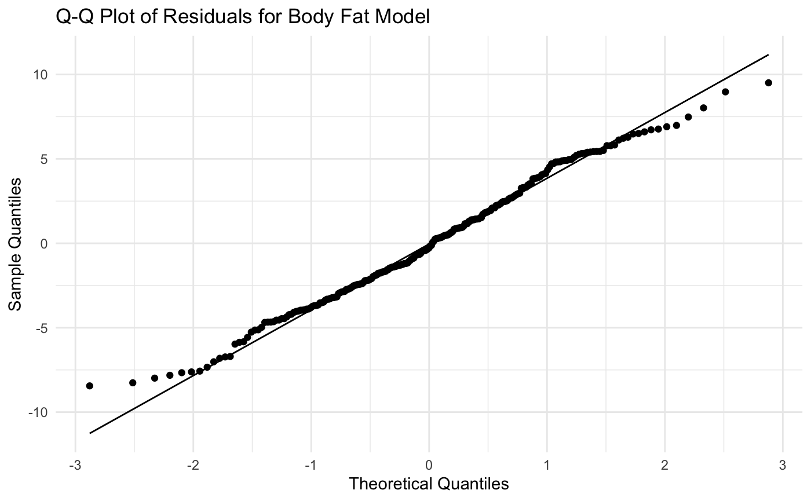
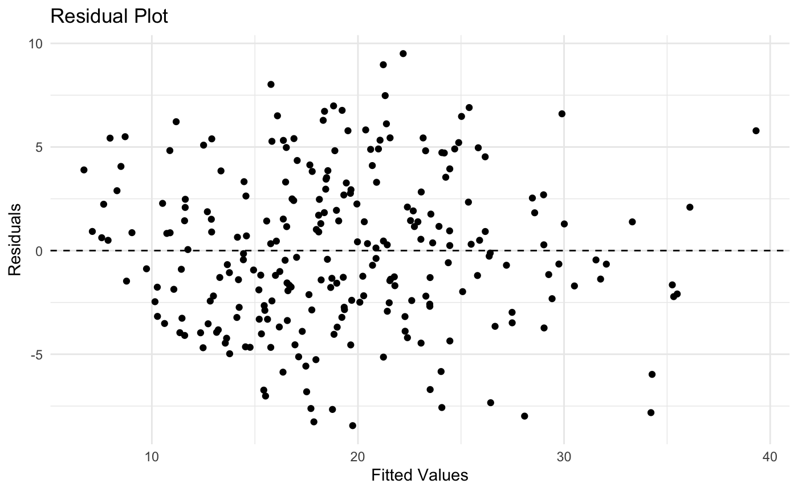
Model Diagnostics
Notes:
The residuals appeared to be approximately normally distributed, as confirmed by the Q-Q plot. Additionally, the residuals vs. fitted values plot showed no clear pattern, indicating that the variance of the residuals is constant, supporting the assumption of homoscedasticity.

Slide 13
Strengths and Weaknesses
Strengths:
Simple and easy to interpret with just three key variables.
Practical for real-world use.
Good balance between simplicity and predictive power.
Weaknesses:
May miss complex relationships, potentially underfitting.
Could improve by adding non-linear terms for better accuracy.

Slide 14
Thanks!

